Slide 1
Sparse Tensor Core: Algorithm and Hardware Co-Design for Vector-wise Sparse Neural Networks on Modern GPUs
Micro 2019
Notes:
此页可以删除

Slide 2
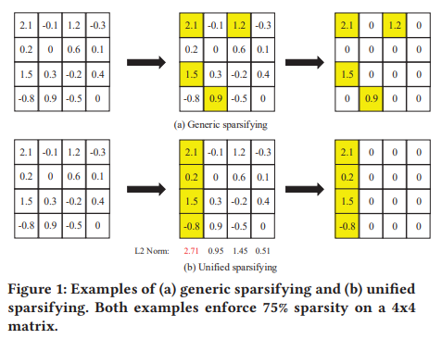
背景
神经网络top-k稀疏性
top-K sparsifying and retraining could result in more than 90% sparsity with negligible impact on the model accuracy->the irregularity of data layout-> CSR incurs poor workload balance ->the GPU is extremely underutilized;
Structured sparsity->drop in accuracy
Existing Sparsifying Methods on GPUs
generic sparsifying and unified sparsifying.
TensorCore
The Tensor Core is a fast hardware functional block for dense matrix multiplication.
Tensor Core has been introduced in Volta architecture to provide 8× peak TFLOPs than the FP32 CUDA -> dense matrix.

Slide 3
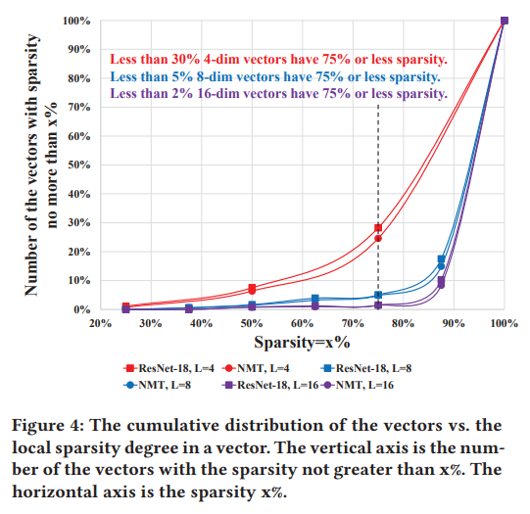
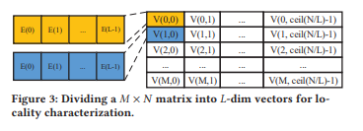
Motivation
non-structured (hard for tensorcore to accelerate) && structured（drop in accuracy）->generic sparsifying (workload, tile, memory access)and unified sparsifying (hard for optimized dense libraries)->find a sparsifying method to achieve better performance than generic sparsifying and meanwhile eliminate the accuracy drop brought by the unified sparsifying->deploy on Tensorcore

Slide 4
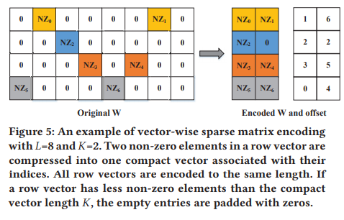
Key design
Vector-wise Sparse Matrix Encoding
VectorSparse divides a weight matrix into multiple vectors and prunes each vector to the same sparsity.->The sparse weight matrices generated by VectorSparse exhibit a better workload balance and higher parallelism than the top-K pruned weight matrices->accelerate the inference phase of applications.

Slide 5
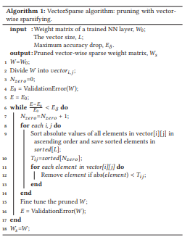
Key point
VectorSparse: a Methodology of Iterative Vector-wise Sparsifying and Retraining
directly pruning a dense weight matrix to a small
K vector-wise encoding could lead to significant accuracy drop of the neural networks -> a spatially even distribution of non-zero elements.->a progressive
pruning method by gradually decreasing K in the vector-wise sparsifying.

Slide 6
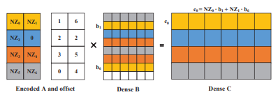
Key point
GPU Kernel Design

Slide 7
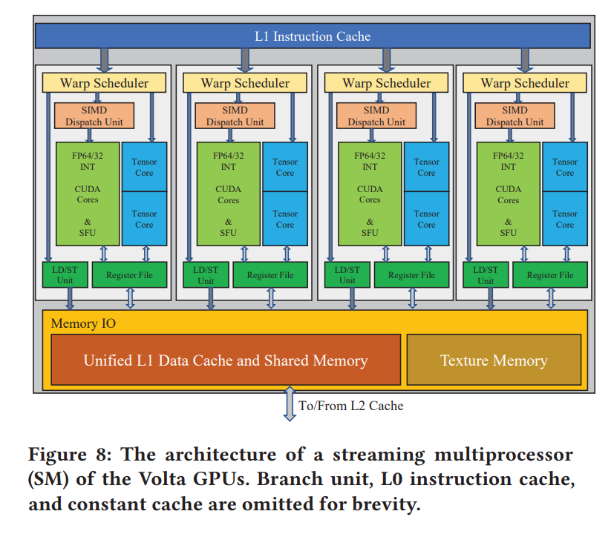
Key point
Tensor Core Design
NVIDIA’s Volta architecture [53]. Each Tensor Core is able to execute a 4×4×4
matrix multiplication and addition in one cycle. The Tensor Core in
Volta GPUs provides two execution modes, FP16 mode and mixed
precision mode. In the FP16 mode,

Slide 8
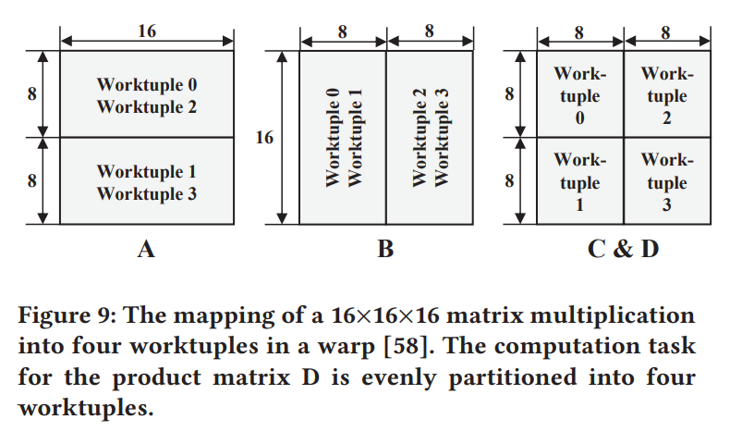
Key point
Tensor Core Design

Slide 9
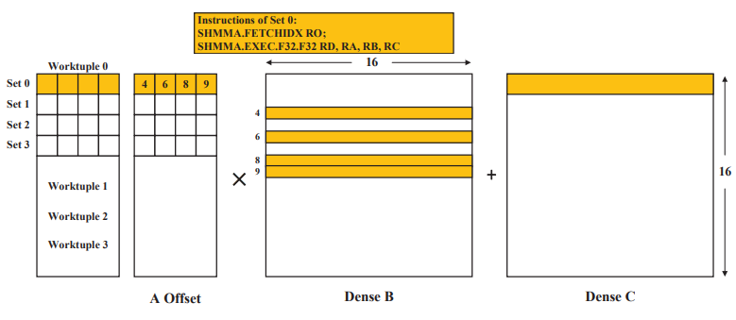

Key point
Micro-architecture Design for Sparse Tensor Core

Slide 10
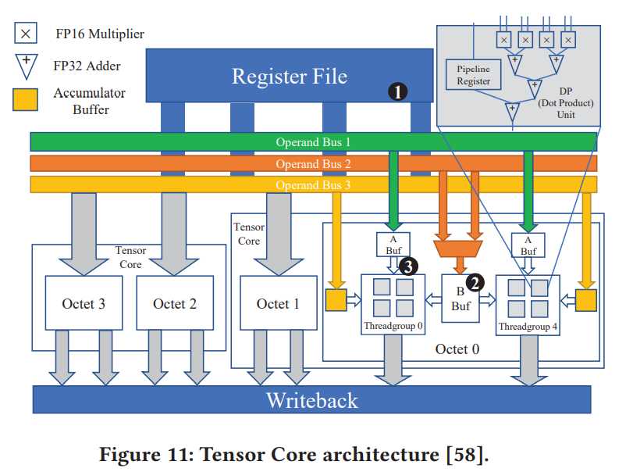
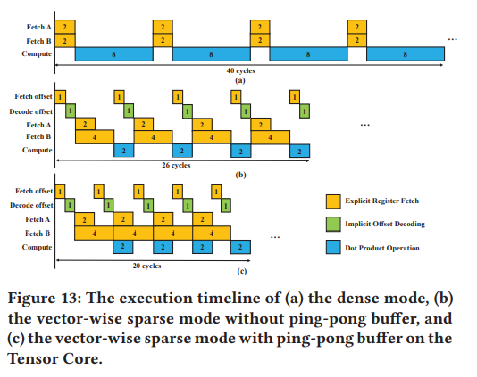
Key point
Micro-architecture Design for Sparse Tensor Core

Slide 11
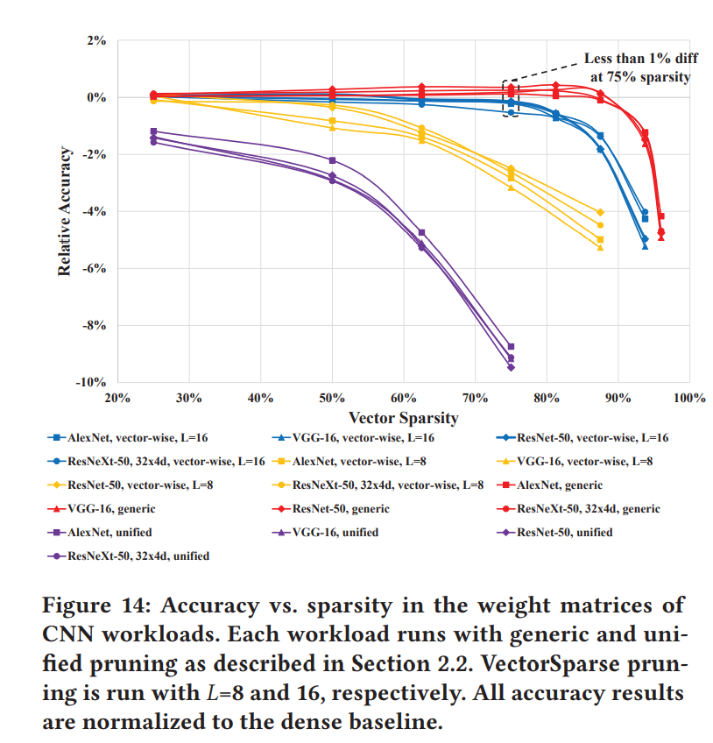
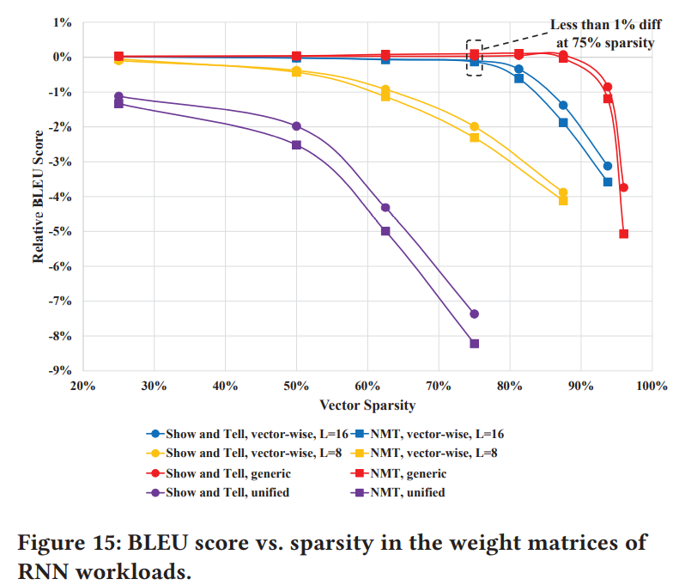
Experiment
Accuracy

Slide 12
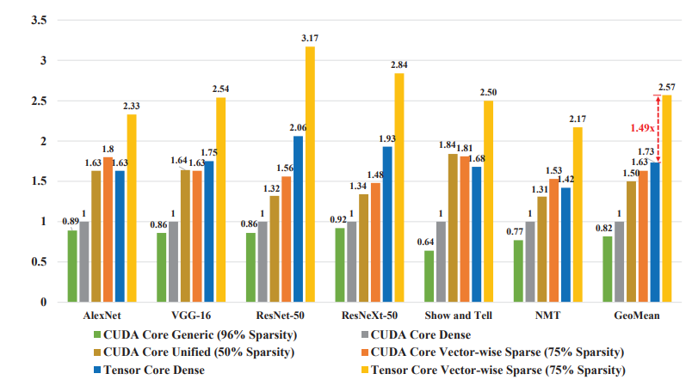
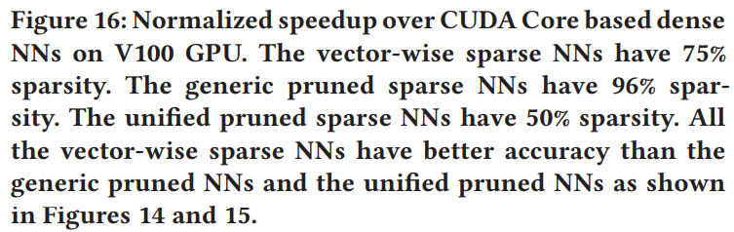
Experiment
Performance

Slide 13
Personal View
对项目的借鉴意义
搜索K的过程。其实本质上是在决定这个编码的大小。本质上是根据对最后的正确率的影响。然后搜索策略的话，感觉可以分为两种。
如果对于要求精度比较高的情况，可以把L设置小一点，K设置大一点，可接受的精度小一点，这种情况下搜索出的稀疏性小一点。
如果对于时延要求比较高的情况，也就是需要稀疏度大一点的情况，设置和上面刚好相反。
本质上我们meta op的大小决定其实感觉和这个决定L和K的过程是一样的。
如果我们是针对balanced-sparsity的这种，给定一个meta op的大小集合的话，利用上面的思路应该是可以搜索出来比较合适的meta op的大小的。
但是对于一些meta op的组合来说，也就是k,L都是不一样的，那么这个搜索的策略。

Slide 14
Personal View
对项目的借鉴意义
因为K，L是相等的，因此这种情况不会引起负载不均衡的问题，但是我们的项目针对K，L的这种负载均衡问题还是要考虑。
之前我们考虑的一直是性能的问题，但是可以从这篇文章里面看出来其实这也会影响最后的精度，因此，我觉得meta op的大小其实应该是在时延和精度之间做一个平衡，也就是可以将硬件返回的cost model的数值作为惩罚项或者精度分数中一部分来指导这个搜索策略。

Slide 15
Thanks！

